Slide 1
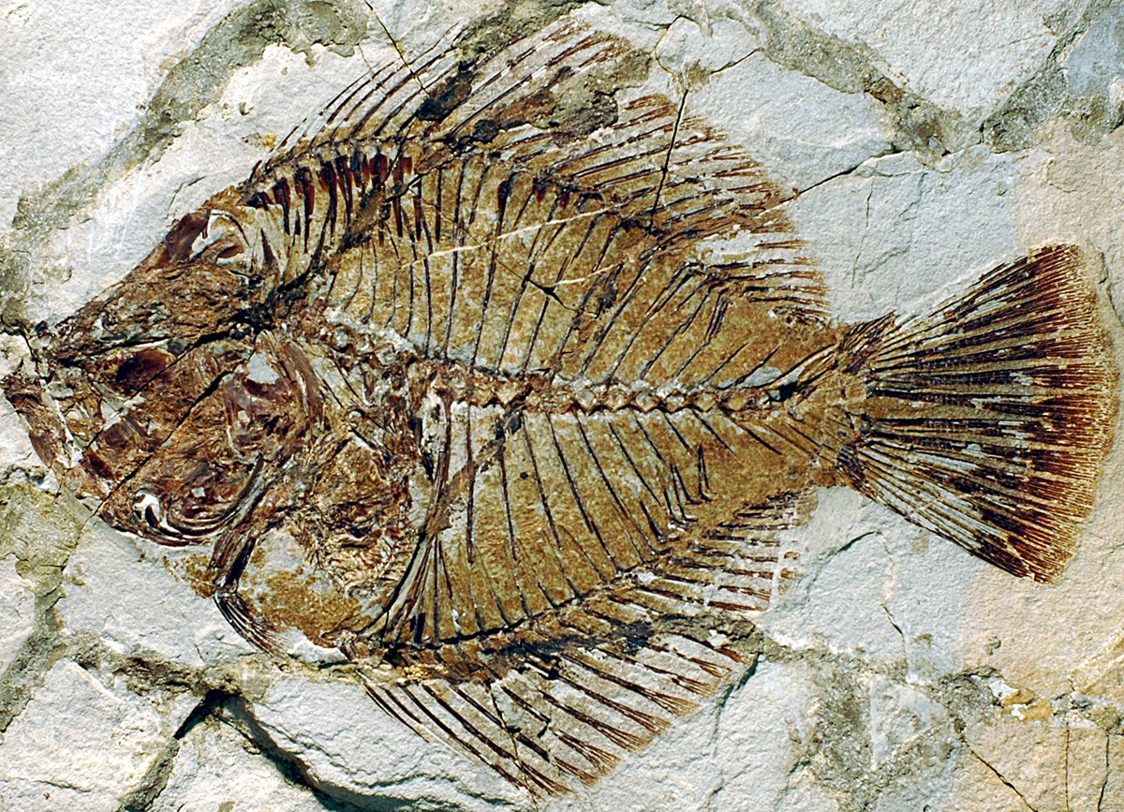
Evidence for Evolution

Slide 2
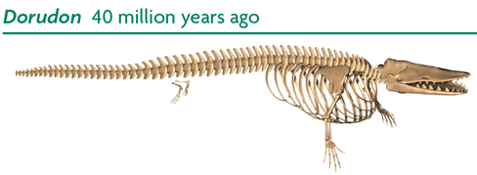
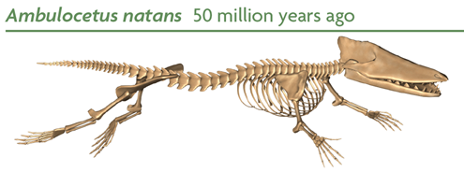
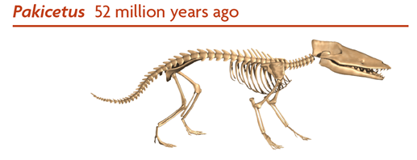
Evidence
Evidence of common ancestry among species comes from many sources.

Slide 3
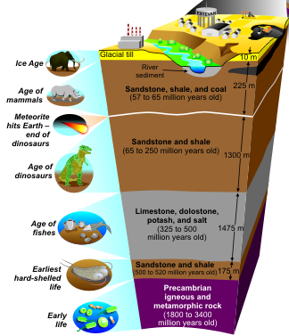
#1 Fossil Evidence
Fossils
  Earth is Millions of years old!
  Fossils in older layers are more primitive than those in the upper layers.
  Extinct Fossils resemble modern animals.
  This shows a common ancestry.

Slide 4
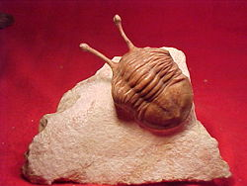
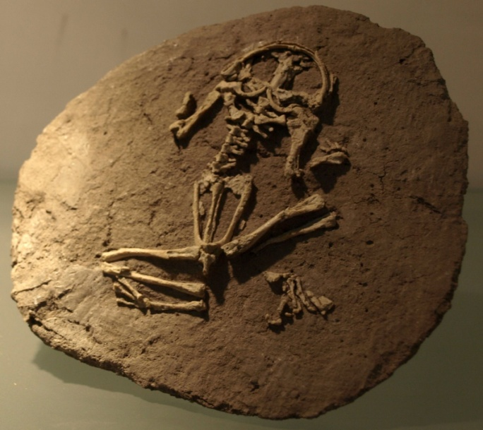
Types of Fossils
Permineralization occurs when minerals carried by water are deposited around a hard structure
A natural cast forms when flowing water removes all of the original tissue, leaving an impression.

Slide 5
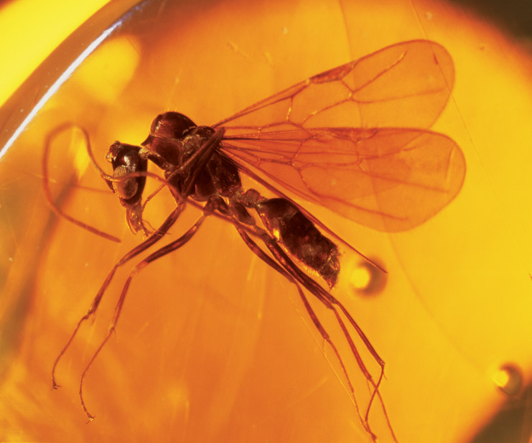
Types of Fossils
Amber-preserved fossils are organisms that become trapped in tree resin that hardens after the tree is buried.
Fossilized insects

Slide 6
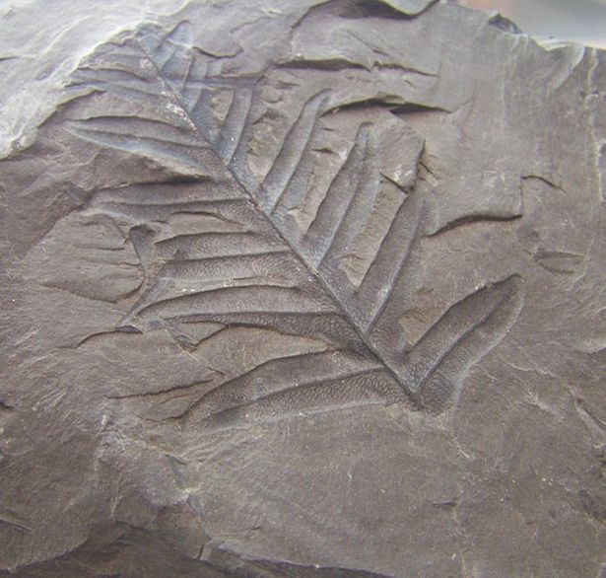
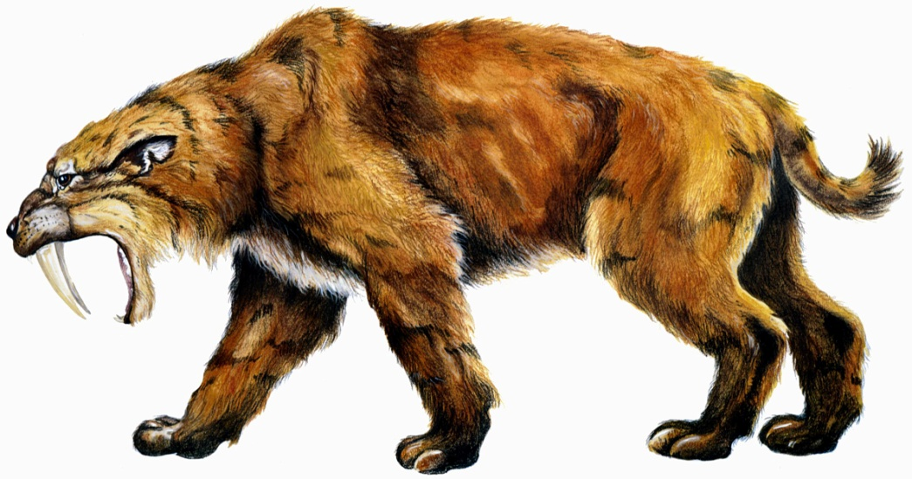
Types of Fossils
Impressions are imprints left in rock
Preserved remains form when an entire organism becomes encased in material such as ice, ash, tar …

Slide 7
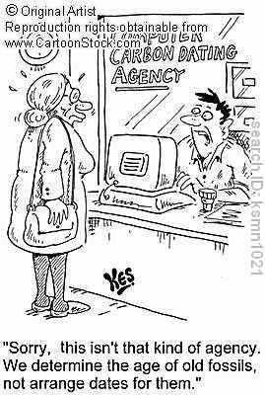
Dating Fossils

Slide 8
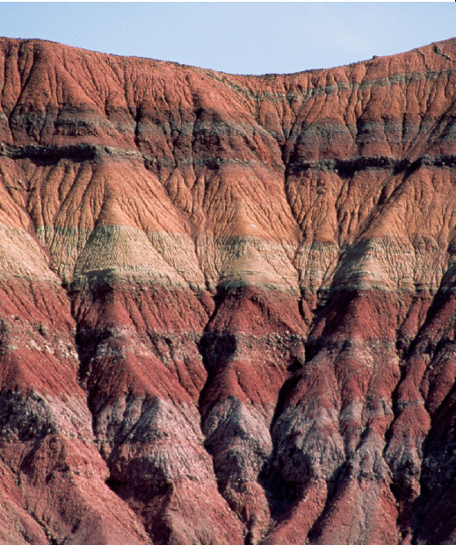
Relative Dating of Fossils
Estimates the time during which an organism lived
It compares the placement
of fossils in layers of rock
Scientists infer the order in which species existed

Slide 9
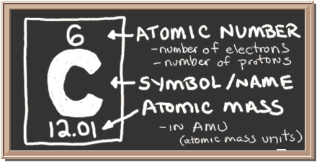
Radiometric Dating of Fossils
Uses Radioactive Isotopes: atoms of the same element with differing neutrons
  Ex: ¹²C and ¹⁴C
  ¹²C = 6 protons + 6 neutrons
  ¹⁴C = 6 protons + 8 neutrons

Slide 10
Radiometric Dating of Fossils
Measures the half-life of the isotope – the time it takes for ½ of the isotope to break down
Carbon-12 stable; Carbon-14 radioactive (carbon in ALL organisms)
Example:
  Carbon-14 has a half-life of 5730 years; decays into Carbon-12
  Compare ratio of C-14 to C-12 to age fossil

Slide 11
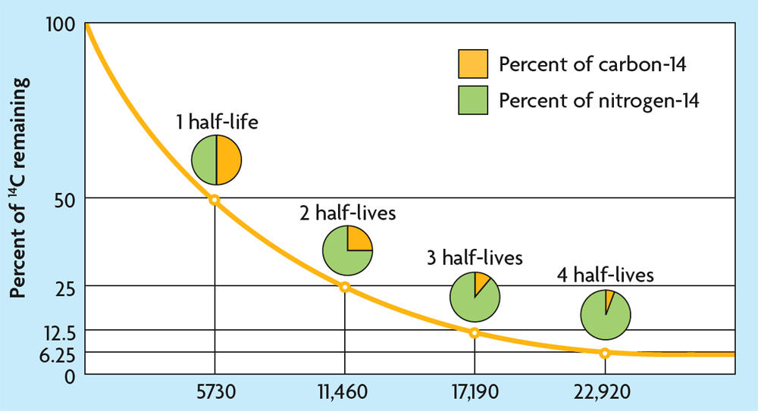
Radiometric Dating of Fossils

Slide 12
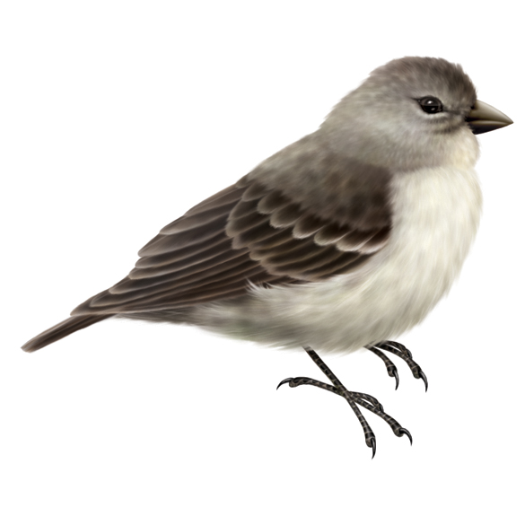
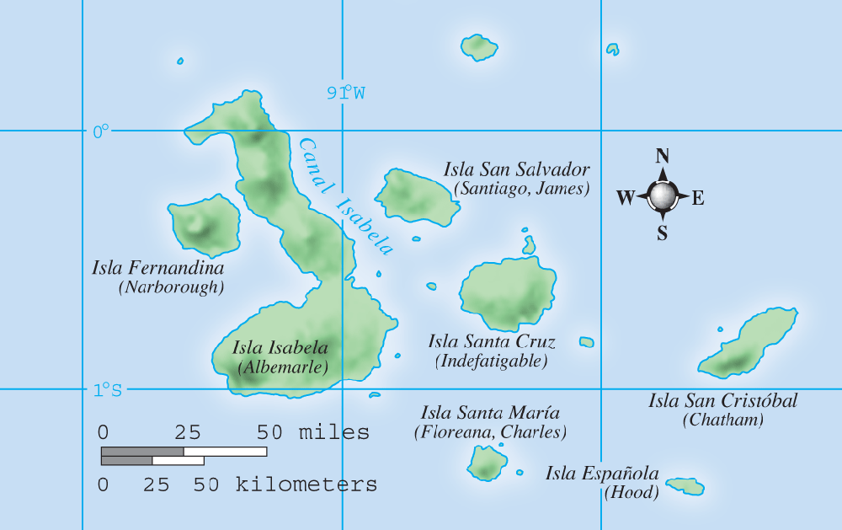
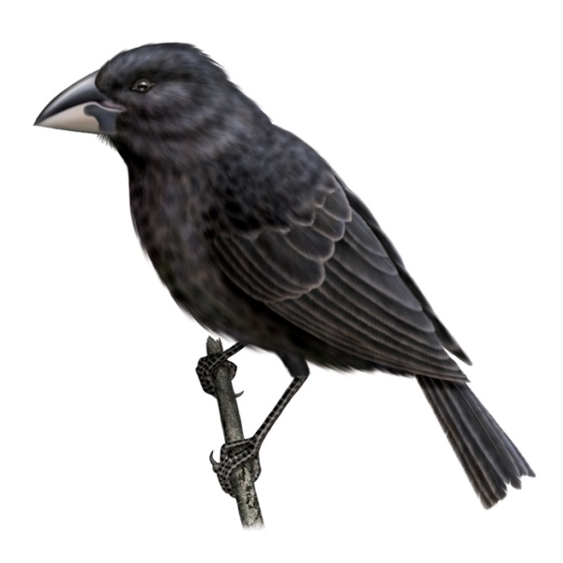
#2 Geographical Distribution
The study of geography provides evidence of evolution
  Island species most closely resemble nearest mainland species
  Populations can show variation from one island to another

Slide 13
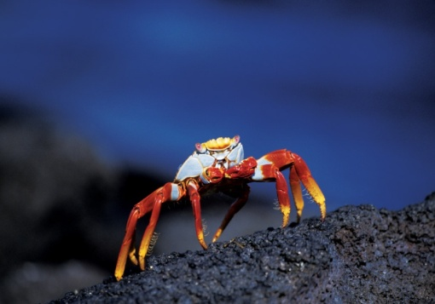
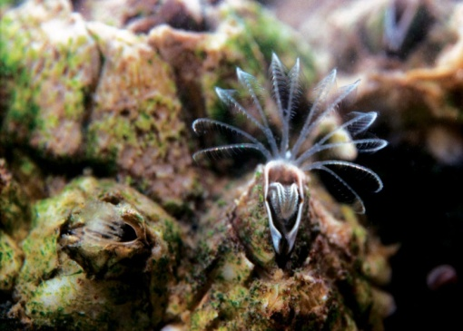
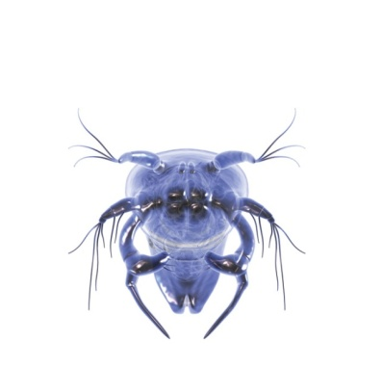
#3 Embryology
Embryology gives evidence of evolution
  identical larvae, different adult body forms
  similar embryos, diverse organisms
  Shows common ancestry
Larva
Adult crab
Adult barnacle

Slide 14
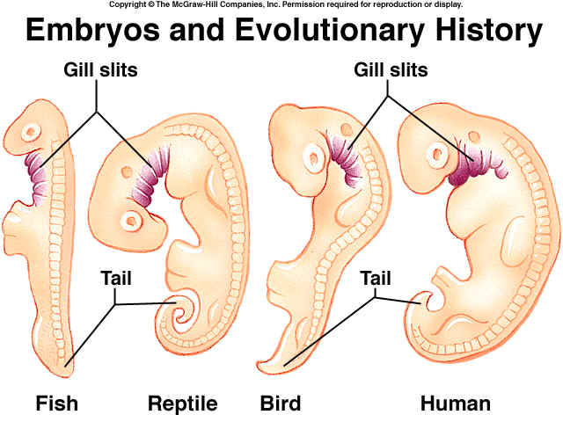
#3 Embryology

Slide 15
#4 Comparative Anatomy
The study of anatomy provides evidence of evolution
  Homologous structures are similar in structure but different in function.
  Homologous structures ARE EVIDENCE of a common ancestor.

Slide 16
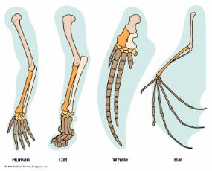
Homologous Structures
ARM
LEG
Flipper
Wing
grasping
walking
swimming
flight

Slide 17
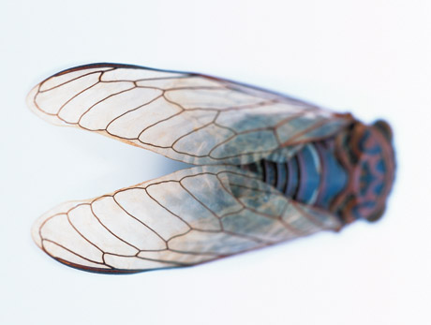
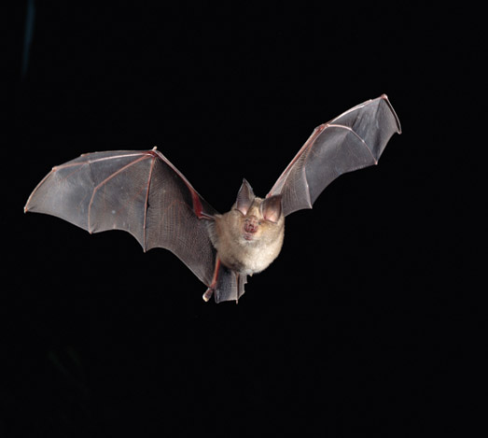
#4 Comparative Anatomy
  Analogous structures are similar in function but differ in structure
  Analogous structures DO NOT show common ancestry
Fly wing
Bat wing

Slide 18
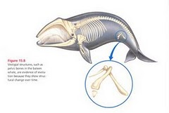
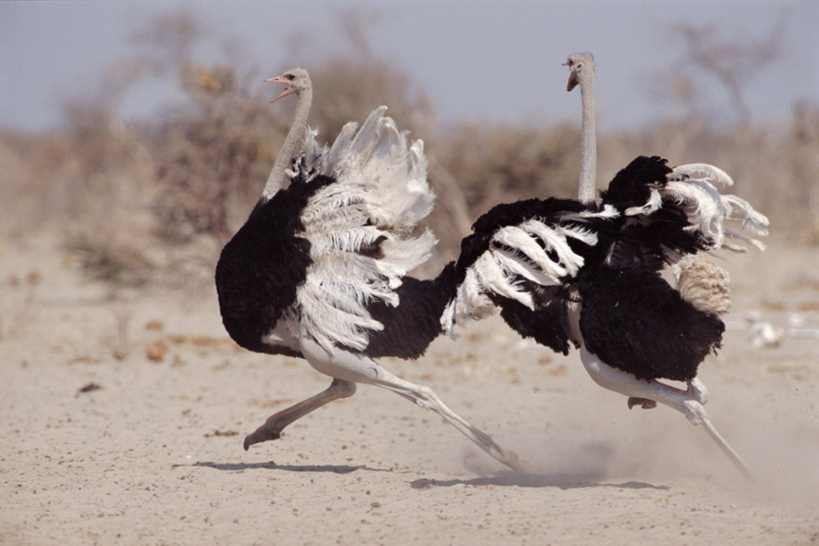
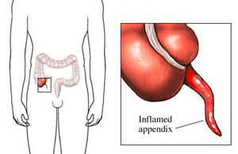
Structural patterns are clues to the history of a species.
Vestigial structures are remnants of organs or structures that had a function in an early ancestor.
Examples include ostrich wings, human appendix, and wisdom teeth, whale and snake pelvis/hind legs

Slide 19
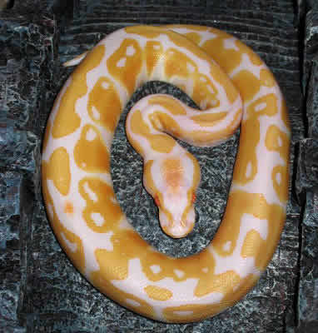
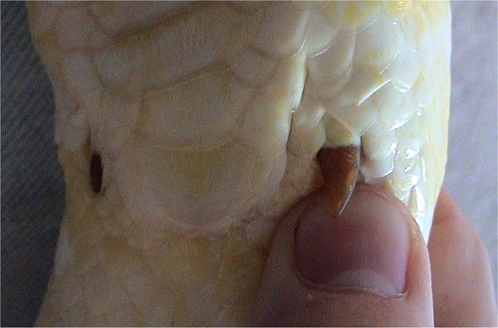
Pythons have tiny femurs (leg bone)

Slide 20
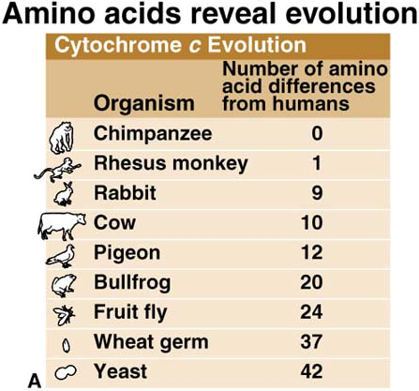
#5 Molecular and Genetic Evidence
AKA Biochemical Evidence
Two closely-related organisms will have similar DNA, RNA, and protein (amino acid) sequences.
This also gives evidence of a common ancestor.

Slide 21
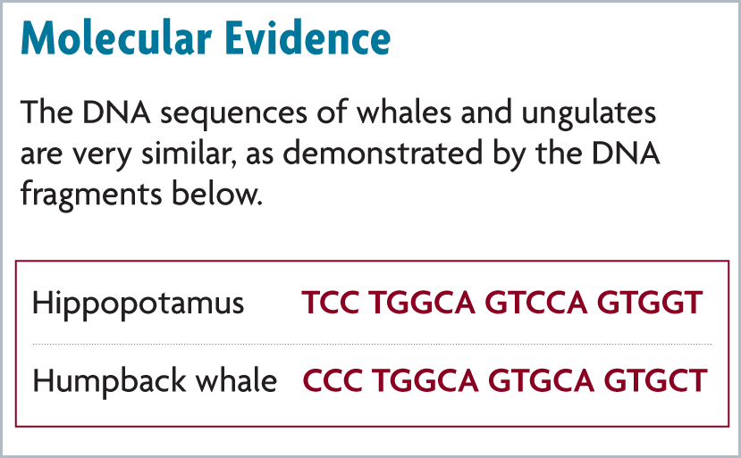

Slide 22
Five examples of Evidence for Evolution
Fossils
Geographical Distribution
Embryology
Comparative Anatomy
Molecular and Genetic

Slide 23
