Slide 1
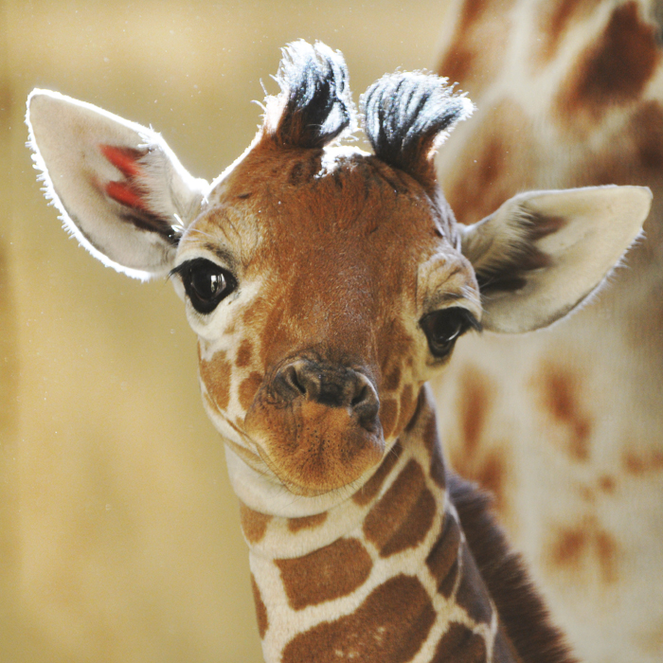
Darwin versus Lamarck
How giraffe’s got longer necks?

Slide 2
Evolution
DARWIN
LAMARCK
Natural Selection
Also called descent with Modification
Original population – members different from each other
Better adapted individuals SURVIVE & REPRODUCE
These genes are kept in the gene pool
Over millions of years, population changes
Inheritance of Acquired Characteristics
Also called law of use and disuse (if used, structure becomes stronger; if NOT, used, structure disappears from future generations
Original population – all members exactly alike
Using a structure changed it (acquired)
Off spring would have the same trait

Slide 3
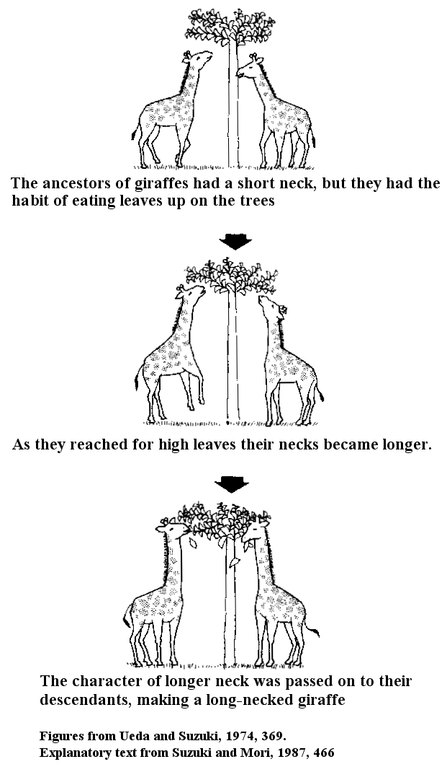
LAMARCK

Slide 4
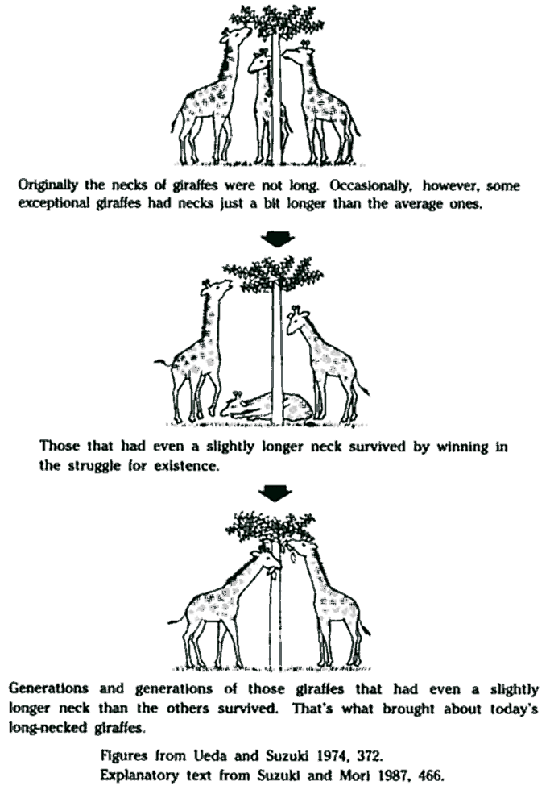
DARWIN

