Slide 1
Today’s Objective
Be able to name tissue types based on a photographic representation or description of the tissue’s function.

Slide 2
Histology
The study of tissues

Slide 3
Epithelial Tissue
Squamous
Cuboidal
Columnar
Notes:
-one of the major kinds of tissue formed in the bodies of human beings and some animals
-covers the body surface
-lines the channels of the body that have openings to the outside
-examples: respiratory tract, alimentary tract, and urinary tract
->squamous cells make up the tissue that covers the body surface and lines the mouth and esophagus
->cuboidal cells line some of the body cavities and are found in many of the glands
->columnar cells lines the stomach and intestines, and the innermost layer of the epidermis (skin). A form of
columnar epithelium equipped with cilia lines the respiratory passages.

Slide 4
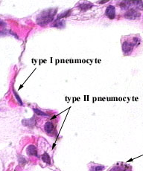

Slide 5
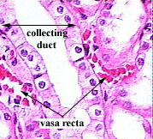

Slide 6
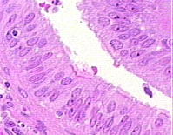

Slide 7
Connective Tissue
Reticular Bone
Areolar Cartilage
Adipose Blood
Dense Regular/Irregular
Notes:
-holds together and gives shape to body organs and tissues
-holds organs in place and supports the body
soft connective tissue proper
firm cartilage
hard bone.
Other dense connective tissue – tendons & ligaments
reticular tissue -> manufacture red and white blood cells

Slide 8
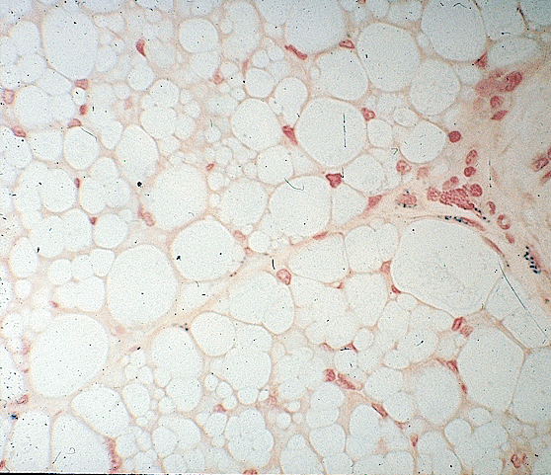
Notes:
Adipose Tissue

Slide 9
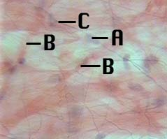
Notes:
Areolar Connective Tissue

Slide 10
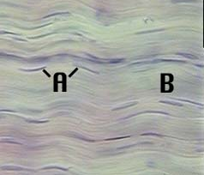
Notes:
Dense regular connective tissue

Slide 11
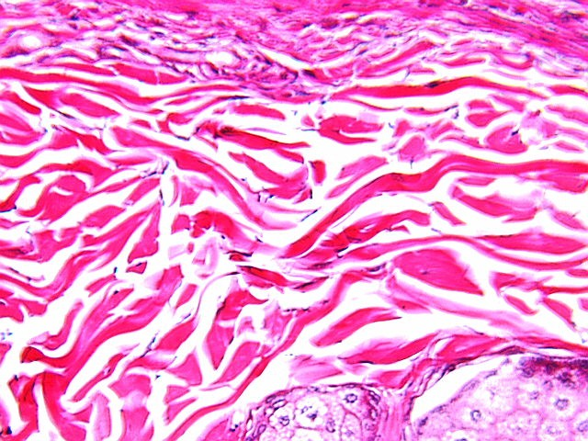
Notes:
Dense irregular connective tissue

Slide 12
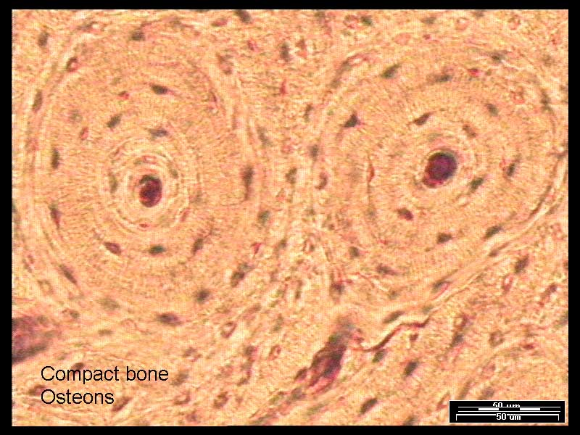
Notes:
Bone – spongy & compact

Slide 13
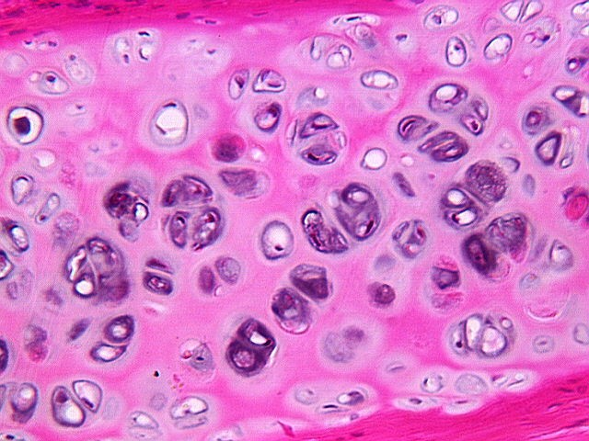
Notes:
Cartilage

Slide 14
Blood
White cells
Red cells
Platelets
Plasma

Slide 15
Muscular Tissue
Smooth
Skeletal
Cardiac

Slide 16
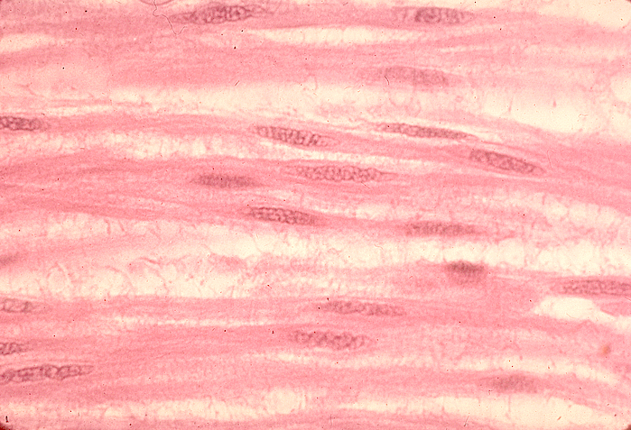
Notes:
Smooth muscle

Slide 17
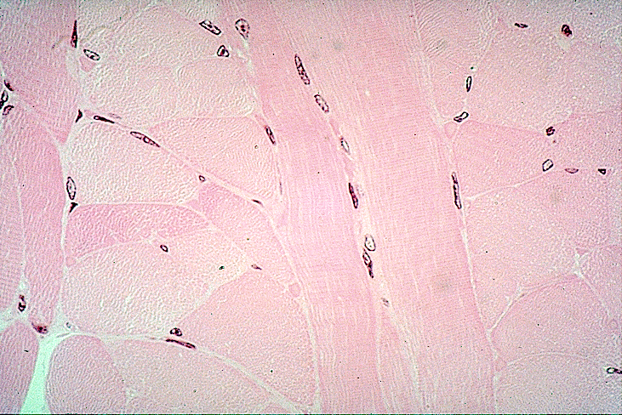
Notes:
Skeletal muscle

Slide 18
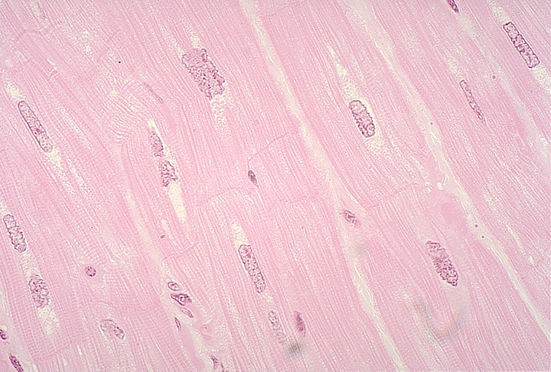
Notes:
Cardiac muscle

