Slide 1
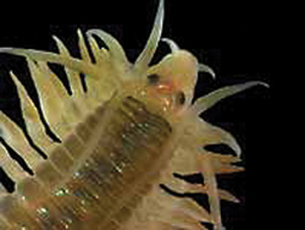
Annelids
The Segmented Worms

Slide 2
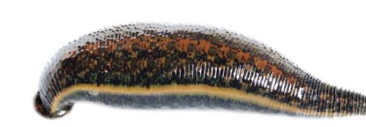
Characteristics
Includes duster worms, earthworms, & leeches
Abundant in all habitats
Have a true coelom fully lined with mesoderm
Body divided into external segments called metameres (metamerism)

Slide 3
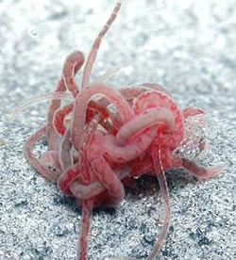
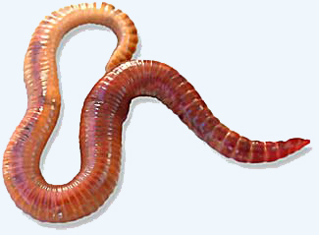
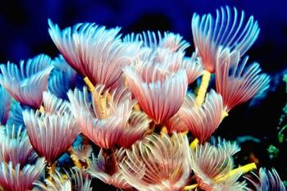
Oligochaetes

Slide 4
Characteristics
Metameres correspond to internal segments
Have a one-way digestive system with a mouth & anus
Well developed brain & sensory organs
Fluid-filled coelom provides hydrostatic skeleton

Slide 5
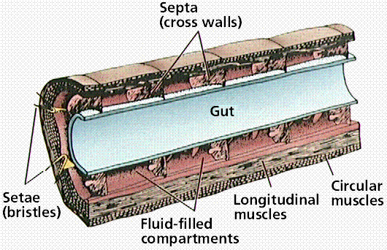
Hydrostatic Skeleton

Slide 6
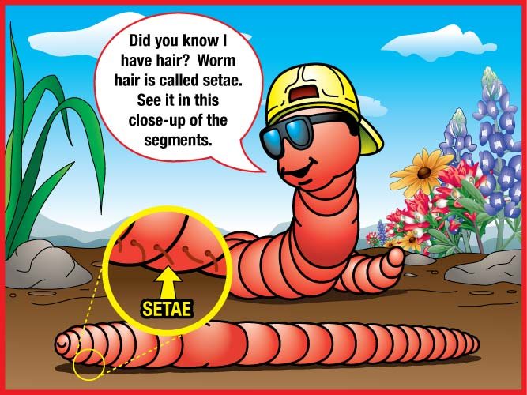
Characteristics
Most have external bristles or setae that aid movement
Setae may be modified into flashy appendages called parapodia

Slide 7
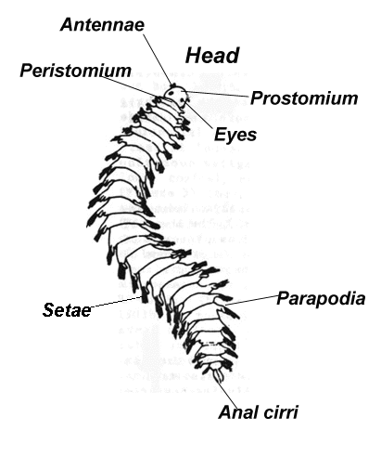
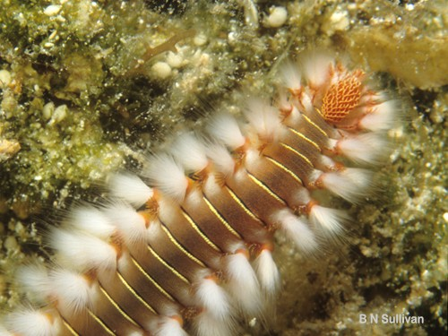
Parapodia

Slide 8
Classification
Includes 3 classes based on number of setae & presence or absence of parapodia
Classes of segmented worms ---
  Oligochaeta
  Polychaeta
  Hirudenia

Slide 9
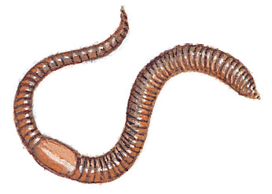
Earthworms
Oligochaeta

Slide 10
Characteristics
Have no parapodia
Few setae for movement
Includes earthworms
Bodies may have over 100 metameres
Internal partitions called septa
Distinct anterior & posterior ends
Bilateral symmetry

Slide 11
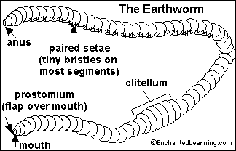
Characteristics
Cephalization (head with sense organs) shows specialization for burrowing
Have both circular & longitudinal muscles for movement
Have external, saddle-shaped structure called clitellum that forms a cocoon containing eggs & sperm

Slide 12
Digestive System
Has both a mouth and anus
Prostomium or lip digs through soil as earthworm feeds on organic matter (detritus)
Pharynx is a muscular organ behind the mouth to help suck in food
Food temporarily stored in crop, ground in gizzard, and digested & absorbed in intestine
Wastes called castings pass out through anus

Slide 13
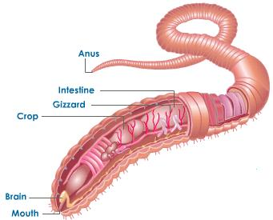
Digestive System

Slide 14
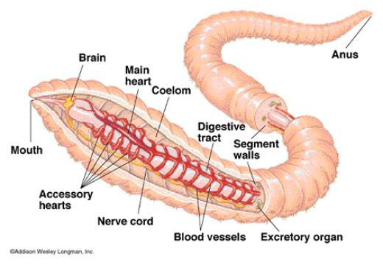
Circulatory System
Closed circulatory system with 5 pairs of aortic arches or hearts
Dorsal blood vessel carries blood posteriorly to cells & ventral blood vessel returns blood anteriorly

Slide 15
Other Systems in Earthworms
Secrete mucus to keep skin moist so oxygen will dissolve & diffuse into body
Long tubules called nephridia filter wastes from blood & excrete it through pores
Simple brain, no eyes, & dorsal and ventral nerve cords
Sensitive to light, touch, moisture, chemicals, temperature, & vibrations
Hermaphrodites exchange sperm & cross-fertilize
Sperm sacs store the worm's own sperm & seminal receptacles store exchanged sperm

Slide 16
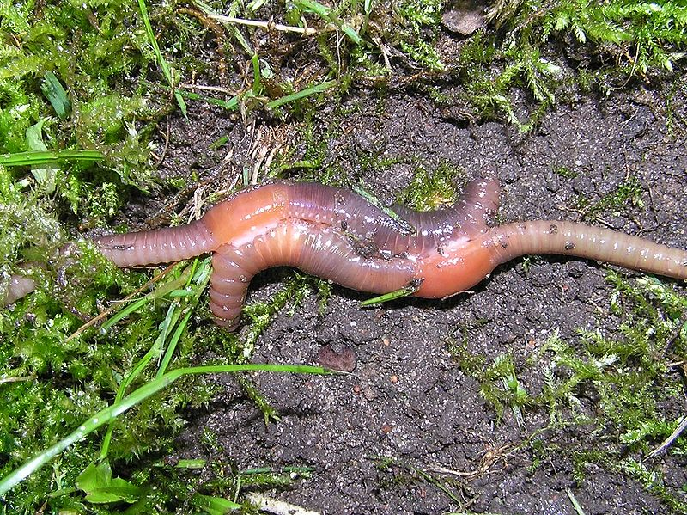
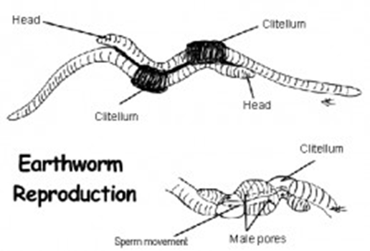
Earthworms Reproducing

Slide 17
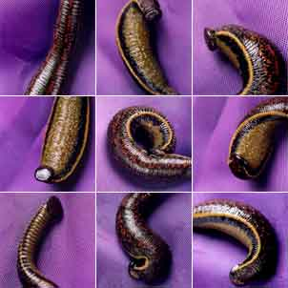
Leeches
Hirudenia

Slide 18
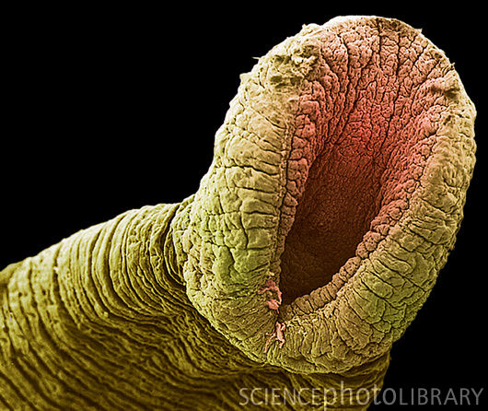
Characteristics of Leeches
No setae or parapodia
Includes leeches
Have anterior & posterior suckers for attachment
Some suck blood from hosts, while others are scavengers or predators

Slide 19
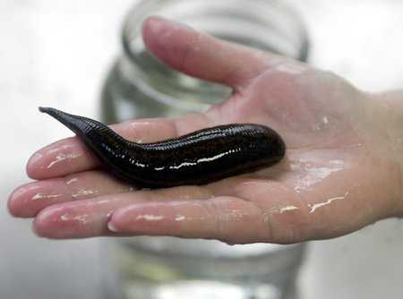
Characteristics of Leeches
Mouth's of blood-sucking leeches with chitinous teeth & secrete anticoagulant
Found in freshwater
Flattened dorso-ventrally
Hermaphrodites that cross-fertilize

Slide 20
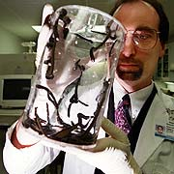
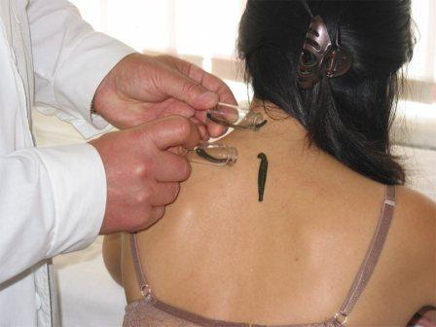
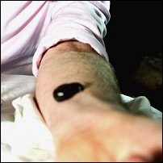
Medicinal Leeches

Slide 21
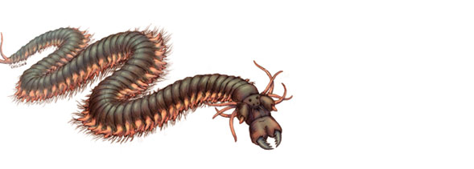
Sandworms & Clamworms
Polychaeta

Slide 22
Polychaete Characteristics
Marine
Includes sandworms & clamworms
Have paddle-like parapodia to move
Take in oxygen through parapodia
Some are free-swimming predators with strong jaws to feed on small animals
Many live commensally with sponges, mollusks, & echinoderms
Well-developed head with antenna & specialized mouthparts

Slide 23
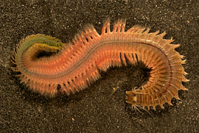
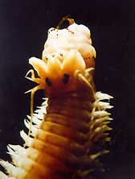
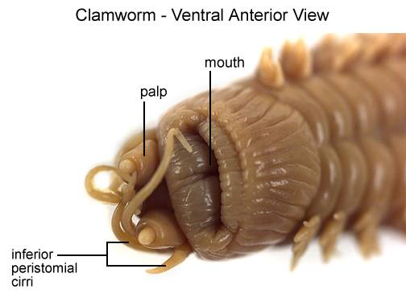
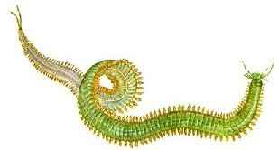
Clamworms

